Slide 1
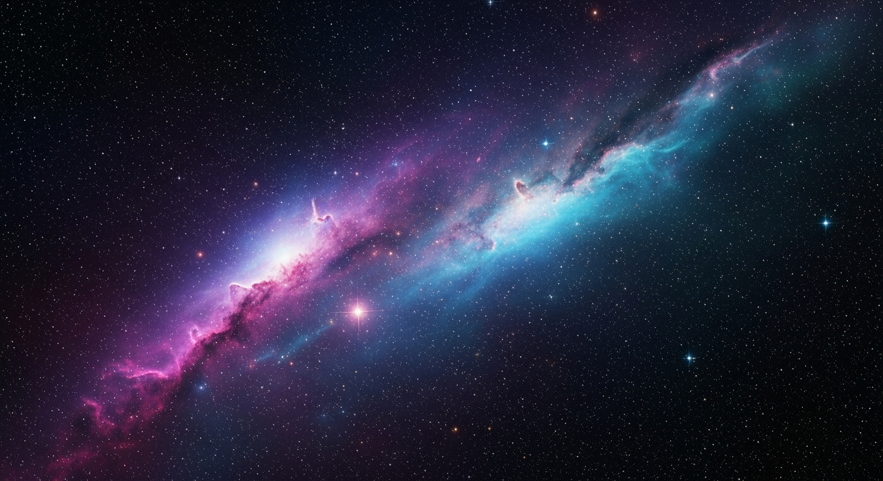
AI-Powered Predictive Maintenance
NASA Deep Space Missions
Ruben Darío Valenzuela Alvarado | July 2025 | Artificial Intelligence Applications – ITAI 2372 | Prof. Anna Devarakonda

Slide 2

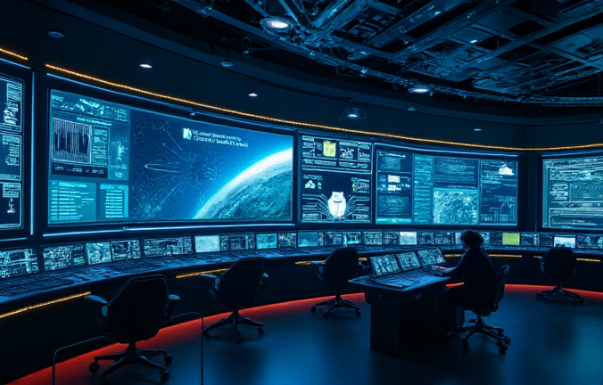
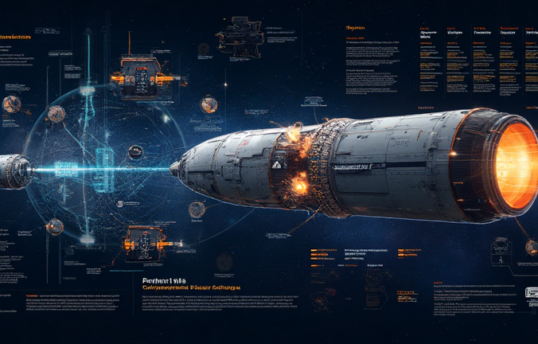
Project Overview
Abstract
This project presents a conceptual AI system designed to predict and prevent equipment failures in NASA deep space missions through advanced sensor analytics and machine learning algorithms.
01
02
Core Mission
Strategic Value
Develop an intelligent predictive maintenance system capable of analyzing real-time spacecraft telemetry data to identify potential failures before they occur, ensuring mission continuity and crew safety.
Address critical challenges in deep space exploration where communication delays and distance make reactive maintenance impossible, requiring autonomous predictive capabilities.

Slide 3
Problem Statement
Critical Challenges in Deep Space Operations
Deep space missions face unprecedented technical challenges where equipment failures can result in mission loss, as demonstrated by recent NASA experiences.
Current maintenance approaches are reactive rather than predictive, leading to unexpected failures that compromise mission success and astronaut safety in hostile environments.
Communication delays up to 20 minutes one-way to Mars prevent real-time troubleshooting
Limited resupply options for missions beyond Earth orbit require self-sufficiency
Recent Starliner mission experienced helium leaks and propulsion system failures in 2024
Equipment failures in deep space cannot be addressed with Earth-based support
Mars Climate Orbiter loss due to undetected anomaly highlights detection importance
Astronaut safety depends on reliable autonomous system health monitoring capabilities

Slide 4
Project Objectives
Mission Goals
Develop an autonomous AI system that ensures spacecraft reliability through predictive analytics and real-time health monitoring for deep space missions.
Primary Objectives
Secondary Objectives
Predict equipment failures 48-72 hours in advance
Optimize maintenance scheduling for mission efficiency
Achieve 95% accuracy in anomaly detection
Reduce unexpected system downtime by 80%
Minimize false positive alerts below 5%
Enable autonomous corrective action recommendations
Safety
Efficiency
Autonomy
Ensure astronaut safety through reliable system health monitoring and predictive failure detection
Maximize mission operational time through optimized maintenance scheduling and resource allocation
Enable spacecraft self-sufficiency with minimal dependence on Earth-based mission control support

Slide 5



AI Technologies
Deep Learning
Neural networks for complex pattern recognition in multi-dimensional sensor data streams from spacecraft subsystems and environmental monitors.
Machine Learning
Real-Time Analytics
Supervised learning algorithms trained on historical NASA mission data to classify normal vs. anomalous spacecraft behavior patterns.
Stream processing algorithms for continuous monitoring and immediate anomaly detection with minimal computational overhead on spacecraft systems.

Slide 6
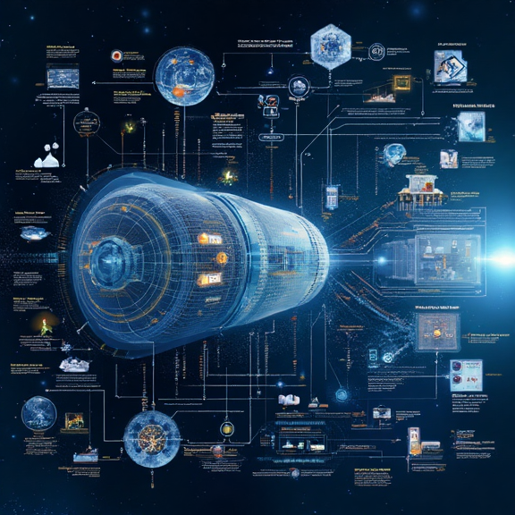
System Architecture
1
1
Data Collection Layer
Network of sensors monitoring propulsion, life support, communications, and navigation systems collecting telemetry data at 1Hz sampling rate for comprehensive spacecraft health assessment.
2
AI Processing Engine
Edge computing unit running machine learning models for real-time anomaly detection, pattern analysis, and predictive algorithms with low latency processing capabilities onboard spacecraft.
2
3
3
Decision Support Interface
Automated alert system providing crew with actionable insights, maintenance recommendations, and system health dashboards integrated with spacecraft control interfaces for immediate response capabilities.

Slide 7
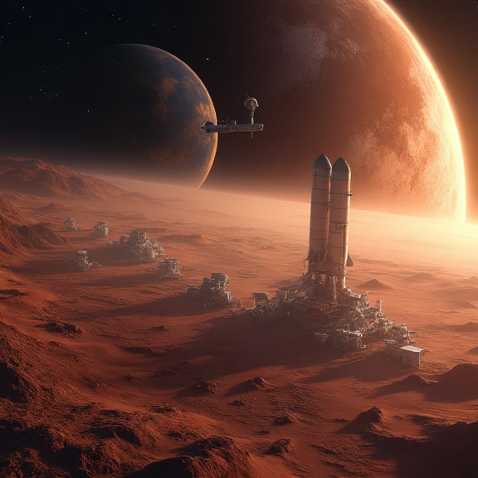
NASA Mission Benefits
Strategic Impact
Cost Savings
Reduce mission costs by up to 40% through prevention of catastrophic failures, optimized maintenance scheduling, and extended equipment lifecycle enabling more ambitious exploration objectives within budget constraints.
Mission Success
Align with NASA's 2040 AI Track initiative to enhance autonomous decision-making capabilities, supporting Artemis lunar missions and future Mars exploration with reliable predictive maintenance systems.

Slide 8
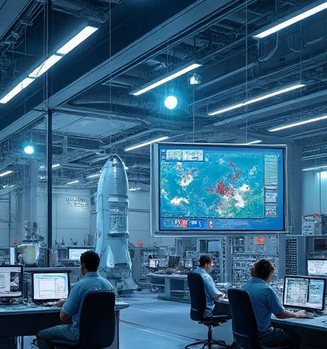
Testing & Evaluation
Validation Methodology
Simulation Testing Phase
Utilize NASA's HERA (Human Exploration Research Analog) facility and ISS data to test AI models under controlled conditions. Validate system performance using historical spacecraft telemetry data from successful and failed missions to ensure robust anomaly detection capabilities.
Hardware Integration Testing
Deploy prototype system on International Space Station for real-world validation of AI algorithms and edge computing performance. Conduct comprehensive stress testing of sensor networks and processing units under actual space environmental conditions including radiation exposure.
Performance Metrics Evaluation
Establish baseline performance criteria including detection accuracy rates, false positive minimization, and response time optimization. Compare system performance against traditional maintenance approaches using standardized NASA mission reliability assessments and safety protocols.

Slide 9
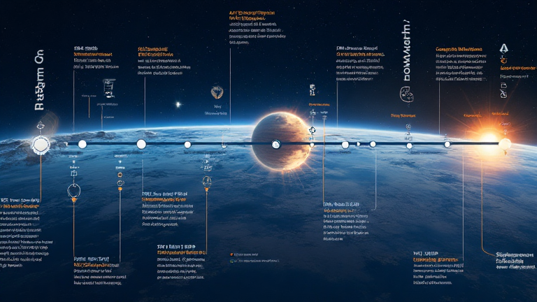
Project Timeline
Development Phase
Testing Phase
Deployment Phase
Months 1-6: Algorithm development, machine learning model training, and initial system architecture design using NASA historical mission data and current AI frameworks.
Months 7-12: Simulation testing, hardware integration, and validation using ISS platform and ground-based testing facilities with performance optimization.
Months 13-18: Final system integration, crew training, and preparation for Artemis and future Mars mission deployment with ongoing support protocols.

Slide 10

Questions & Discussion
Thank You
This AI-powered predictive maintenance system represents a crucial advancement for NASA's deep space exploration capabilities, ensuring mission success and astronaut safety through intelligent autonomous monitoring and failure prevention technologies.

